Slide 1


CSE 445 / 598
Distributed Software Development
Chapter 4 XML and Related Technologies
Lecture 16: XML Schema
Dr. Yinong Chen
https://myasucourses.asu.edu/

Slide 2
Roadmap
XML Fundamentals
Elements, Attributes, and Documents, representation
XML Processing
XML Readers, XML Writer, XPath
XML Type Definition and Validation
Document Type Definition (DTD)
XML Schema
Validation
XML Style Language and Transformation
XSL, XSLT
Google Data Representation and Management
Lecture 16

Slide 3
Why Do We Need Type and Schema Definition?
Is this a good XML element?
<time>
<hour>12</hour>
<minute>72</minute>
<second>-5</second>
</time>
<time>
<hour>18</hour>
<minute>59</minute>
<second>2</second>
</time>
Is this instance OK?

Slide 4
Apply Business Rules to Validate Data
<time>
<hour>18</hour>
<minute>59</minute>
<second>2</second>
</time>
XML
Rule
Validator
Valid?
Data OK
hour: integer between 0 and 23
minutes: integer between 0 and 59
second: integer between 0 and 59
1
12
Data not OK
Rules

Slide 5
XML Document Type Definition (DTD)
A piece of information can be encoded in an XML document in different ways.
When the information is transferred from the source to its destination, the receiver needs to know how the document is structured and need to check if the content is indeed compliant with the structure.
DTD provides organization and rules for the XML document instance, or holds information about the structure of the grammar of an XML document.
A DTD file can be defined in a separate file (external/global DTD) or within the XML document itself (internal/local DTD).

Slide 6
Syntax Definition of DTD
<!DOCTYPE root-element
[
doctype-declarations
]> consists of the name of the root element and a list of document type declarations, each of which is:
<!ELEMENT element-name content-model>
defines a pattern that associates a content model to an element of the given name;
Content-models: You can define your content model to allow:
EMPTY: no content is allowed for the element
ANY: any content is allowed for the element
(#PCDATA | element-name | ...)*: parsed character data

Slide 7
Syntax Definition of DTD (contd.)
Expression over element names when defining an element:
choice: (a | b | c)
sequence: (a, b, c)
optional: a?
zero or more: b*
one or more: c+

Slide 8
Example of DTD within an XML file
, sequence
DTD
File defining the rules
<?xml version = ‘1.0’ encoding=‘utf-8’>
<!DOCTYPE instructor [
<!ELEMENT instructor (name, (course+), OfficeHours, (phone | email))>
<!ELEMENT name (first, (middle?), last)>
<!ELEMENT course (#PCDATA)>
<!ELEMENT OfficeHours (#PCDATA)>
<!ELEMENT phone (#PCDATA)>
<!ELEMENT email (#PCDATA)>
<!ELEMENT first (#PCDATA)>
<!ELEMENT middle (#PCDATA)>
<!ELEMENT last (#PCDATA)>
]>
<instructor>
<name>
<first>Yinong</first>
<last>Chen</last>
</name>
<course>Distributed Software Development</course>
<course>Introduction to Programming Languages</course>
<officeHours>4</officeHours>
<email>yinong@asu.edu</email>
</instructor>
+: at least one
? optional
| OR
XML file (Instance) complies to the DTD file
Does not support “integer”

Slide 9
Example of Using an External DTD file
<!DOCTYPE instructor [
<!ELEMENT instructor (name, (course+), OfficeHours, (phone | email))>
<!ELEMENT name (first, (middle?), last)>
<!ELEMENT course (#PCDATA)>
<!ELEMENT OfficeHours (#PCDATA)>
<!ELEMENT phone (#PCDATA)>
<!ELEMENT email (#PCDATA)>
<!ELEMENT first (#PCDATA)>
<!ELEMENT middle (#PCDATA)>
<!ELEMENT last (#PCDATA)>
]>
instructor.dtd
<?xml version = ‘1.0’ encoding=‘utf-8’>
<!DOCTYPE instructor SYSTEM “http://venus.eas.asu.edu/WSRepository/xml/instructor.dtd”>
<instructor>
<name>
<first>Yinong</first> <last>Chen</last>
</name>
<course>Distributed Software Development</course>
<officeHours>4</officeHours>
<phone>480-965 2769</phone>
</instructor>

Slide 10
Defining Attributes
instructor.dtd
<!EMEMENT course (#PCDATA)>
<!ATTLIST course level CDATA #REQUIRED
text CDATA #IMPLIED
campus CDATA “Tempe”
>
Attribute is optional, no default provided
Default value if not provides
CDATA allowed
<course
level = “senior”
text = “Service-Oriented Architecture & Computing”
campus = “Downtown” >
Distributed Software Development
</course>
Must be PCDATA, see previous page

Slide 11
DTD Vocabulary (Namespace)
New vocabulary
name
course
CDATA
NMTOKEN
instructor
last
first
ID
ELEMENT
officeHours
ENTITY
#PCDATA
ATTLIST
Values for each name: must be
#PCDATA
Type
This is the vocabulary that DTD provides to define your new vocabulary

Slide 12
XML Validation Using DTD
instructor.xml
User defined
instructor.dtd
User Defined DTD
Validate
The xml document
must conform with the
rules described
in instructor.dtd

Slide 13
What is XML Schema and Why?
Like DTD, XML Schema defines an XML vocabulary for expressing your data's business rules
XML Schema is a more powerful alternative to DTD that defines the structure (grammar) of an XML document. The advantages of the schema over DTD include:
DTD is not XML-based and requires separate tools to process DTD documents, while XML Schema is XML-based. The same tools can be used for parsing and processing XML documents, as well as XML Schema documents.
XML Schema is extendable and reusable. One can easily add new types, restricting existing types, and combine existing schemas.
DTD is limited to string type of data. XML schema can define many different types similar to a typical programming language, such as integer, float, string, and structures.

Slide 14
XML Schema Definition (XSD)
In an XML document, the schema is introduced through an element with an opening tag <xsd:schema>, which is the root element, and
with a number of optional attributes, e.g., referring to the source and version:
<schema xmlns ="http://www.w3.org/2000/10/XMLSchema" version = "1.0">
This schema namespace includes elements and datatypes that can be used to construct schemas:
schema
element
complexType
sequence
boolean
integer
string

Slide 15
Types Defined in XML Schema W3C 2001
Forty-four (44) built-in types, in which 19 are simple (primitive) and 25 are derived complex types.
User can define further types of simple and complex
Complex types are defined using simple types
Type inheritance: Extend one type from an existing type

Slide 16
Definition of New Simple Types
Use an element to define a new type with a name and an associated type
Use a single built-in type to define a new type
Use a namespace to tell where the element and type used come from.
<?xml version="1.0" encoding="UTF-8"?>
<xsd:schema xmlns:xsd=http://www.w3.org/2001/XMLSchema
<xsd:element name="Title" type="xsd:string"/>
<xsd:element name="Author" type="xsd:string"/>
<xsd:element name=“Date" type="xsd:date"/>
<xsd:element name="ISBN" type="xsd:string"/>
<xsd:element name=“Publisher" type=“xsd:string "/>
</xsd:schema>
namespaces

Slide 17
Example: XML Schema of A Bookstore
root
<?xml version="1.0" encoding="UTF-8"?>
<xsd:schema xmlns:xsd="http://www.w3.org/2001/XMLSchema"
targetNamespace= "http://venus.eas.asu.edu/WSRepository/xml"
elementFormDefault="qualified" attributeFormDefault="unqualified">
<xsd:element name="Book">
<xsd:complexType>
<xsd:sequence>
<xsd:element name="Title" type="xsd:string"
minOccurs="1" maxOccurs="1"/>
<xsd:element name="Author" type="xsd:string"
minOccurs="1" maxOccurs="unbounded"/>
<xsd:element name="Year" type="xsd:integer"
minOccurs="0" maxOccurs="1"/>
<xsd:element name="ISBN" type="xsd:string"
minOccurs="0" maxOccurs="1"/>
</xsd:sequence>
</xsd:complexType>
</xsd:element>
<xsd:element name="Bookstore">
<xsd:complexType>
<xsd:sequence>
<xsd:element name="Book" minOccurs="1" maxOccurs="unbounded"/>
</xsd:sequence>
</xsd:complexType>
<xs:attribute name= “Address" type="xsd:string" use="required"/>
</xsd:element>
<xsd:element name= "First" type="xsd:string"/>
<xsd:element name= "Last" type="xsd:string"/>
</xsd:schema>
namespaces
complexType
complexType
simpleType

Slide 18
Definition of Complex Types
Use an element to define a new type with a name;
Use sub elements to define the components of the new type;
Specify the allowed number of appearances of each component;
Use namespaces to tell where the element and types used come from;
Use different kinds of combination options.

Slide 19
Definition of complexType
You can define the members of a complexType using three different options:
sequence: All members must appear in the given order
choice: Only one of the list members is allowed
all: All members must appear (unless minOccurs=“0" ), but can be in any order
<xsd:element name="Book">
<xsd:complexType>
<xsd: sequence >
<xsd:element name="Title" minOccurs="1" maxOccurs="1"/>
<xsd:element name="Author" minOccurs="1" maxOccurs="unbounded"/>
<xsd:element name=“Year" minOccurs=“0" maxOccurs="1"/>
<xsd:element name="ISBN" minOccurs=“0" maxOccurs="1"/>
</xsd: sequence >
</xsd:complexType>
all
all

Slide 20
Choice of complexType
<xsd:element name="Book">
<xsd:complexType>
<xsd:sequence>
<xsd:element name="Title" />
<xsd:element name="Author" />
<xsd:element name=“Year" />
<xsd:choice>
<xsd:element name="ISBN-10" />
<xsd:element name="ISBN-13" />
</xsd:choice>
</xsd:sequence>
</xsd:complexType>
</xsd:element name="Book">

Slide 21
Namespaces
A namespace is declared as an attribute of an element.
It binds a prefix name (qualifier) to a schema definition, and then uses that prefix wherever required;
It is not mandatory to declare namespaces at the root element; Namespaces could be declared at any element in the XML document;
The scope of a declared namespace applies to the entire content of that element;
Namespace can be overridden: An inner namespace declaration with the same prefix name (qualifier) will override the outer namespace.

Slide 22
Namespaces
schema
element
complexType
sequence
boolean
integer
string
<?xml version="1.0" encoding="UTF-8"?>
<xsd:schema
xmlns:xsd="http://www.w3.org/2001/XMLSchema"
targetNamespace="http://venus.eas.asu.edu/WSRepository/xml"
xmlns="http://venus.eas.asu.edu/WSRepository/xml/bookstore.xsd"
elementFormDefault="qualified"
attributeFormDefault="unqualified">
Inherit all names from XMLSchema, plus
types being defined in this schema
Bookstore
Book
Title
Author
Date
ISBN
Publisher
4 combinations
This is a directive to any instance documents which conform to this schema: Any elements used by the instance document must be namespace qualified. But the attributes do not need to be qualified
Define this namespace as the default namespace. The names in the default namespace do not need to be qualified

Slide 23
Target Namespace
http://www.w3.org/2001/XMLSchema
schema
element
complexType
sequence
boolean
integer
string
targetNamespace = "http://venus.eas.asu.edu/WSRepository/xml"
schema
element
complexType
sequence
boolean
integer
String
Bookstore
Book
Title
Author
Date
ISBN
Publisher
http://venus.eas.asu.edu/WSRepository/xml
merge
Bookstore
Book
Title
Author
Date
ISBN
Publisher

Slide 24
Default Namespace
It is painful to repeatedly qualify an element or attribute you wish to use from a namespace;
You can declare a default namespace;
Important: at any point in time, there can be only one default namespace;
Declaring a default namespace means that any element within the scope of the namespace will be qualified implicitly, if it is not already qualified explicitly using a prefix.
The name of the default namespace is simply xmlns
xmlns = "http://venus.eas.asu.edu/WSRepository/xml/"

Slide 25
Set xsd as the default namespace
<?xml version="1.0" encoding="UTF-8"?>
<schema xmlns="http://www.w3.org/2001/XMLSchema"
targetNamespace="http://venus.eas.asu.edu/WSRepository/xml/"
xmlns:bs="http://venus.eas.asu.edu/WSRepository/xml/bookstore.xsd"
elementFormDefault="qualified" attributeFormDefault="unqualified">
Define the XML Schema as the default namespace. The names in the default namespace do not need to be qualified
Now bookstore name space is no longer default. The elements defined in it must be qualified by “bs”.

Slide 26
Example: XML Schema of A Bookstore
No default namespaces
<?xml version="1.0" encoding="UTF-8"?>
<xsd:schema xmlns:xsd="http://www.w3.org/2001/XMLSchema"
targetNamespace= "http://venus.eas.asu.edu/WSRepository/xml"
elementFormDefault="qualified" attributeFormDefault="unqualified">
<xsd:element name="Bookstore">
<xsd:complexType>
<xsd:sequence>
<xsd:element name="Book" minOccurs="1" maxOccurs="unbounded"/>
</xsd:sequence>
</xsd:complexType>
</xsd:element>
<xsd:element name="Book">
<xsd:complexType>
<xsd:sequence>
<xsd:element name="Title" type="xsd:string" minOccurs="1" maxOccurs="1"/>
<xsd:element name="Author" type="xsd:string" minOccurs="1" maxOccurs="unbounded"/>
<xsd:element name="Year" type="xsd:string" minOccurs="0" maxOccurs="1"/>
<xsd:element name="ISBN" type="xsd:string" minOccurs="0" maxOccurs="1"/>
<xsd:element name="Publisher" type="xsd:string" minOccurs="0" maxOccurs="1"/> </xsd:sequence>
</xsd:complexType>
</xsd:element>
<xsd:element name=“First" type="xsd:string"/>
<xsd:element name=“Last" type="xsd:string"/>
</xsd:schema>

Slide 27
Better Choice of Default Namespace
Default
namespace
<?xml version="1.0" encoding="UTF-8"?>
<schema xmlns="http://www.w3.org/2001/XMLSchema"
targetNamespace= "http://venus.eas.asu.edu/WSRepository/xml/"
xmlns:bs ="http://venus.eas.asu.edu/WSRepository/xml/bookstore.xsd"
elementFormDefault="qualified" attributeFormDefault="unqualified">
<element name="Bookstore">
<complexType>
<sequence>
<element name="Book" minOccurs="1" maxOccurs="unbounded"/>
</sequence>
</complexType>
</element>
<element name="Book">
<complexType>
<sequence>
<element name="Title" type="xsd:string" minOccurs="1" maxOccurs="1"/>
<element name="Author" type="xsd:string" minOccurs="1" maxOccurs="unbounded"/>
<element name="Year" type="xsd:string" minOccurs="0" maxOccurs="1"/>
<element name="ISBN" type="xsd:string" minOccurs="0" maxOccurs="1"/>
</sequence>
</complexType>
</element>
<element name=“First" type="string"/>
<element name=“Last" type="string"/>
<element name=“Size" type=“bs:DIN"/>
</schema>
Complex
Type
Complex
Type
Simple
Type

Slide 28
Using a Schema in an Instance
xmlns:
Default XML namespace
xsi:
XML Schema Instance
<?xml version="1.0"?>
<Bookstore xmlns ="http://venus.eas.asu.edu/WSRepository/xml/"
xmlns:bs ="http://venus.eas.asu.edu/WSRepository/xml/bookstore.xsd"
xmlns:xsi="http://www.w3.org/2001/XMLSchema-instance"
xsi:schemaLocation="http://venus.eas.asu.edu/WSRepository/xml/bookstore.xsd">
<Book>
<Title>Introduction to Programming Languages</Title>
<Author>Yinong Chen</Author>
<Author>W.T. Tsai</Author>
<Year>2014</Year>
<ISBN>978-1-4652-4700-1</ISBN>
<Size>10x8</Size>
</Book> ...
</Bookstore>
xsi
is used to define the location

Slide 29
Default Namespace and Attributes
Prefixed namespace and the default namespace do not apply to attributes within the element;
To apply a namespace to an attribute, the attribute must be explicitly qualified.
In the example below, the attribute “edition” has no namespace, whereas the attribute “cover” is associated with the namespace bs.
Default namespace
<Book xmlns = "http://venus.eas.asu.edu/WSRepository/xml/">
<Title bs: cover = “paperback” > Programming Languages </Title>
<Author>Yinong Chen</Author>
<Author>W.T. Tsai</Author>
<Year edition = “2” >2006</Year>
<ISBN>0-7575-2974-7</ISBN>
</Book>

Slide 30
Summary of XML Schema Example
schema element
complexType sequence
choice all boolean
integer string …
XML Schema Namespace
http://www.w3.org/2001/XMLSchema
schema element
complexType sequence
choice all boolean
integer string …
vocabulary
<?xml version="1.0" encoding="UTF-8"?>
<schema xmlns="http://www.w3.org/2001/XMLSchema"
targetNamespace= "http://venus.eas.asu.edu/WSRepository/xml/"
…
<element name="bookstore">
…
</element>
<element name="Book">
…
</element>
User-Defined Schema
<bookstore …>
<Book>
<Title>SOC</Title>
…
</Book>
</bookstore>
element boolean integer,
bookstore Book Title
Author Year ISBN
Publisher
Instance
vocabulary

Slide 31
Multiple Levels of Validation
http://validator.w3.org/
bookstore.xsd
Schema doc
User defined
XMLSchema.xsd
schema-for-schemas
W3C Standard
bookstore.xml
User defined
Validate
Validate
The xml instance document
conforms with the
rules described
in bookstore.xsd and
in W3C standard
bookstore.xsd
is a valid schema
document, i.e., it
conforms with the rules
described in the
schema-for-
schemas

Slide 32
Case Study http://www.nws.noaa.gov/mdl/XML/Design/MDL_XML_Design.pdf
Digital Weather Markup Language (DWML)
DWML is an XML language for supporting the exchange of the National Weather Service’s (NWS) National Digital Forecast Database (NDFD) data;
Also other environmental science applications. DWML site provides a definition of DWML types based on restrictions.
Weather forecast services: http://www.weather.gov/, Enter City, State names
7-day forecast data downloadable in the format of http://forecast.weather.gov/MapClick.php?lat=33.43417&lon=-112.05111&FcstType=dwml

Slide 33
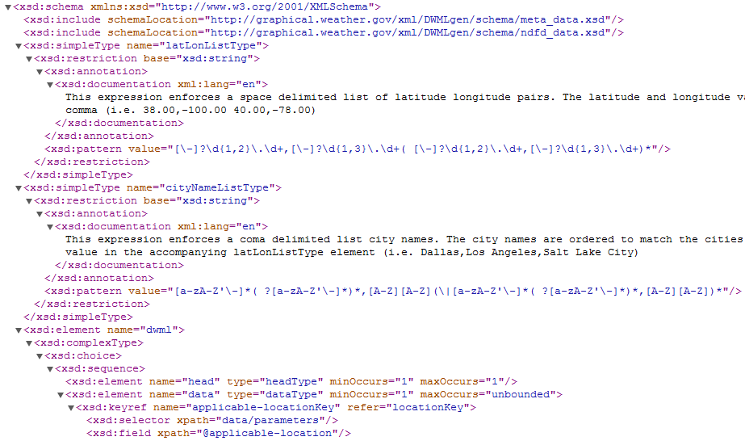
DWML XML Schema http://graphical.weather.gov/xml/DWMLgen/schema/DWML.xsd

Slide 34
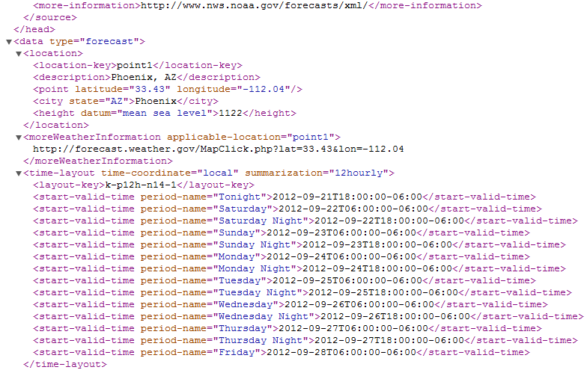
Instance of the Schema: Phoenix Seven-Day Weather Data Download http://forecast.weather.gov/MapClick.php?lat=33.43417&lon=-112.05111&FcstType=dwml

Slide 35
To Get Forecast from the URL http://forecast.weather.gov/MapClick.php?lat=33.43417&lon=-112.05111&FcstType=dwml
// The operation takes latitude and longitude as inputs, and obtain 7-day forecast
public void GetForecast(string latitude, string longitude) {
// form the URI
UriBuilder fullUri = new UriBuilder("http://forecast.weather.gov/MapClick.php");
fullUri.Query = "lat=" + latitude + "&lon=" + longitude + "&FcstType=dwml";
// initialize a new WebRequest: RESTful style service access
HttpWebRequest forecastRequest = (HttpWebRequest)WebRequest.Create(fullUri.Uri);
// set up the state object for the async request
ForecastUpdateState forecastState = new ForecastUpdateState();
forecastState.AsyncRequest = forecastRequest;
// start the asynchronous request
forecastRequest.BeginGetResponse(
new AsyncCallback(HandleForecastResponse), forecastState);
}

Slide 36
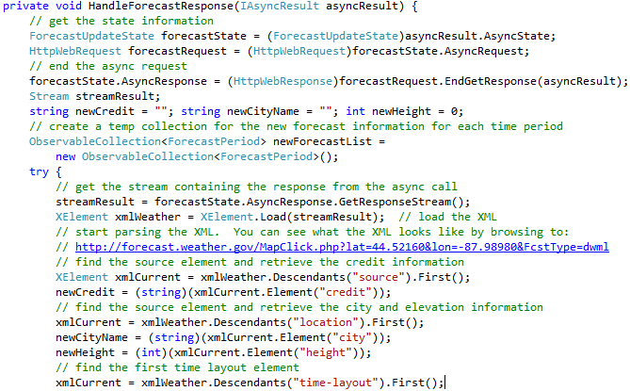
Process the Forecast Response (XML File)
Asynchronous invocation
Read Text 10.4.5: LINQ to XML Processing

Slide 37
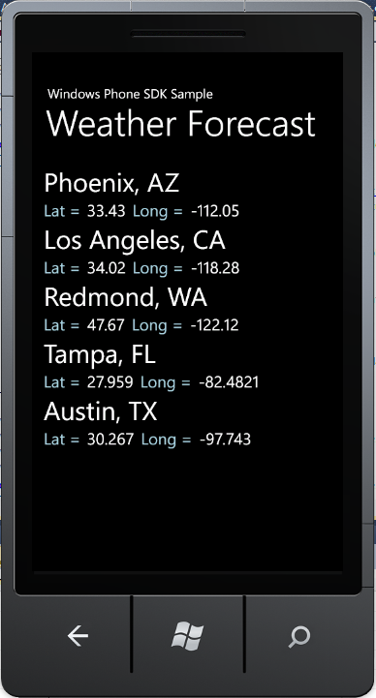
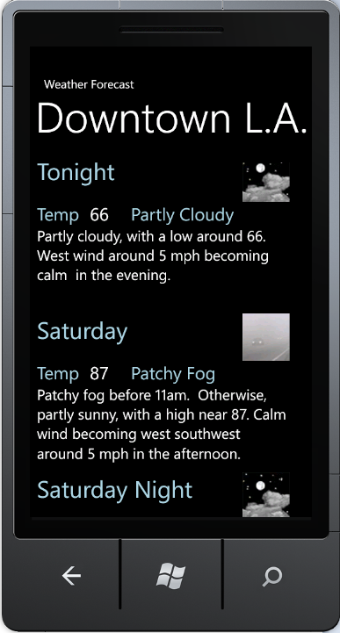
Extract and Display the Weather Info

